Slide 1
Trip Planning using Public and Private Transport
By: Tasneem Lightwala
Guide: Prof. Abhiram Ranade

Slide 2
Trip Planning
Finding optimal path between two locations
Road networks:
Junctions as vertices
Edges between vertices if road connects them
Shortest path algorithms give optimal route between origin and destination
Public transport networks:
Bus stops and bus lines
Buses follow specific route as per schedule
Travel plans of the form: { {(v₁,v₂),b₁} , {(v₂,v₃),b₂} ,.. {(v_{n-1},v_{n}),b_{n-1}} }
Cannot apply shortest path algorithms due to Time-dependence and Multi-Criteria nature.

Slide 3
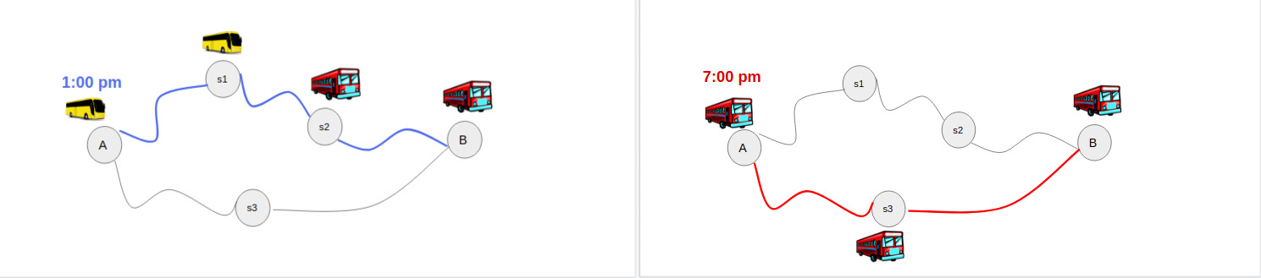
Public Transport Networks: Time dependence
Buses can travel at only specific points of time

Slide 4
Public Transport Networks: MultiCriteria
Minimum travel time
Minimum travel cost
Minimum transfers
s1
s2
A
B
s3

Slide 5
Problem variants of Trip planning
Earliest Arrival Problem: find travel plan that leaves origin at given departure time and reaches destination as early as possible
Range Problem: find travel plan that leaves origin at any time in time range and minimizes travel time
Multicriteria problem: find all non dominating travel plans optimizing given criterion.

Slide 6
Route Planning in Road Networks
Basic Techniques:
Dijkstra’s algorithm
Bellman-Ford algorithm
Floyd Warshall algorithm

Slide 7
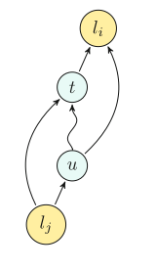
Route Planning in Road Networks
Goal-Directed Techniques: directs search towards destination by avoiding vertices not in direction of destination.
A* search:
uses potential function 𝛑: V->R on vertices to find lower bound on dist(u,t)
Modified Dijkstra’s is run with priority of vertex u as dist(s,u) + 𝛑(u)
Vertices closer to destination are scanned earlier.
Better lower bounds with ALT (A*, landmarks and triangle inequality)
Triangle inequalities used to obtain lower bounds for dist(u,t)
dist(u,t) ≥ dist(u, l_{i}) - dist(t, l_{i}) & dist(u,t) ≥ dist(l_{i},t) - dist(l_{i},u)
ALT

Slide 8
Route Planning in Road Networks
Geometric Containers:
Each edge e(u,v) stores label L(e) containing vertices to which shortest path from u begins with edge e.
During query, if destination vertex not in L(e), search can be pruned at e.
Costly as requires pre computation of all-pairs shortest path.
Arc Flags:
Preprocessing: partitions graph into balanced K cells
Each edge maintains K-bit vector with i-th bit set if the arc lies on shortest path to some vertex of cell i.
prune edges not having bit set to the cell containing destination vertex.
Fastest among goal-directed methods for road networks

Slide 9
Route Planning in Road Networks
Separator based Techniques:
Vertex Separators:
Split graph into smaller graphs by removing small set of vertices called separators
Set of important vertices chosen as separators S.
For each pair of vertices u,v in S, add edge (u,v) if shortest path from u to v does not contain any other vertex w from S.
Smaller graph, fast query processing

Slide 10
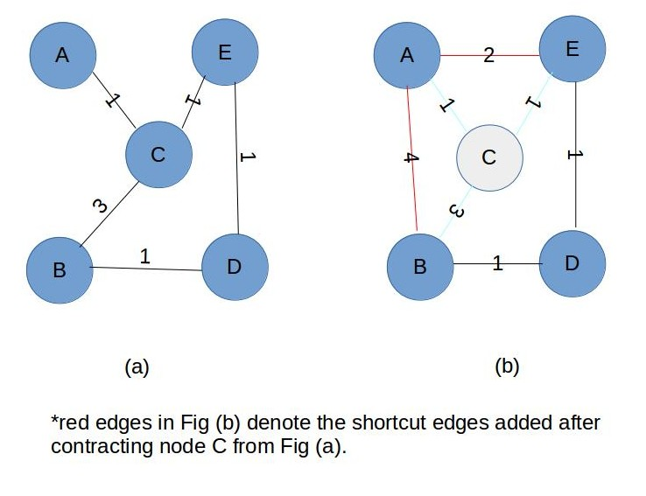
Route Planning in Road Networks
Hierarchical Techniques: long shortest paths eventually converge to a small network of important roads, such as highways.
Contraction Hierarchies:
Preprocessing a graph: Performing contraction of a node.
Finding shortest path: only edges that goes towards higher contraction order node from current node are considered while performing simultaneous search from origin and destination and finding the intersection point.
No. of nodes (UK) | No. of edges | Shortcut edges added | Nodes visited while finding solution
3,478,051 | 7,646,738 | 6,186,168 | 3,617

Slide 11
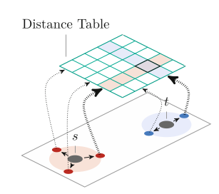
Route Planning in Road Networks
Bounded-Hop Techniques: The idea is to precompute distances between pairs of vertices, implicitly adding “virtual shortcuts” to the graph. Queries then returns the length of a virtual path with very few hops.
Transit Node Routing
Transit nodes
Access nodes
Select path that minimizes s-a(s)-a(t)-t distance

Slide 12
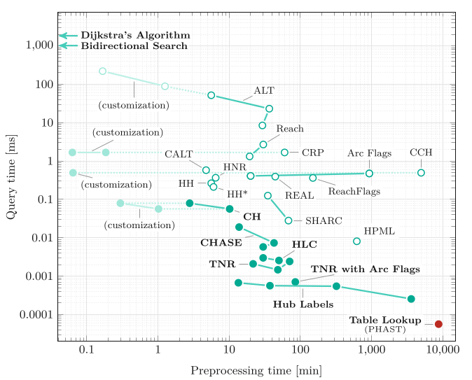
Route Planning in Road Networks: Comparison

Slide 13
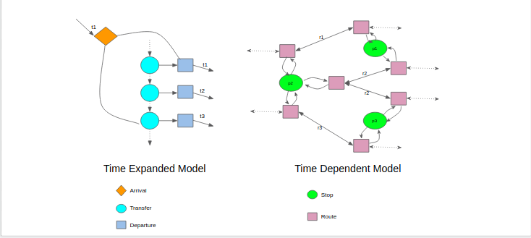
Trip Planning using Public Transport
Modeling: build a graph G(V,A) from timetable (stops, trips) in such a way that shortest path in G corresponds to optimal journeys.

Slide 14
Frequency based algorithm
Bus schedules are not reliable
Input: origin, destination
Output: given travel plan with minimum expected time
Waiting time for a bus is random
Assumption: Bus arrivals are poisson distributed
Expected time between arrivals of bus = 1 / F(b)

Slide 15
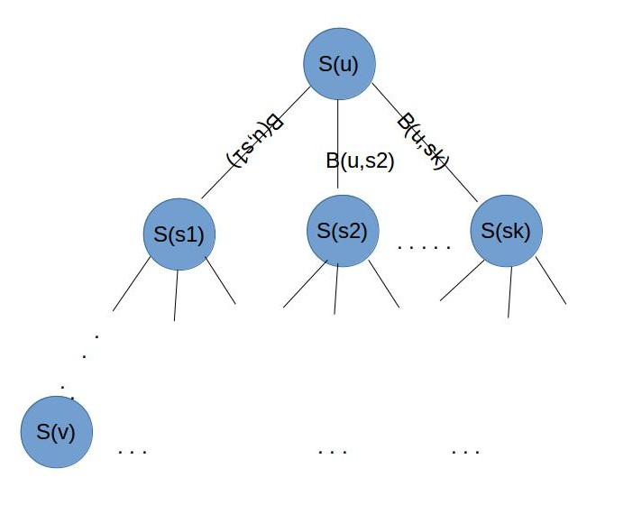
Adaptive travel plans:
Wait at S(u) for buses B(u,s1),B(u,s2),...B(u,sk).
If B(u,si) arrives first, take it till stop S(si) and execute the action indicated by si.
Subtrees also represent plan trees, therefore expected time calculation takes place recursively.

Slide 16
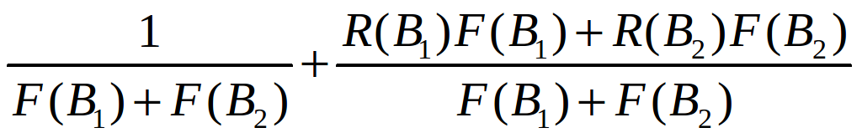
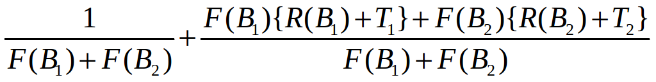
Expected time of a plan:
origin
origin
B1
B2
B1
B2
destination
destination
Subplan 1
Expected time T1
Subplan 2
Expected time T2

Slide 17
Algorithm:
Only subset B of B_{s} considered
Sort all B_{s} buses based on running time
Compute waiting time , running time for first i buses
Find j s.t. running time for bus B_{j+1} is greater than sum of waiting and running time for bus B_{j}
Use buses 1..j as B

Slide 18
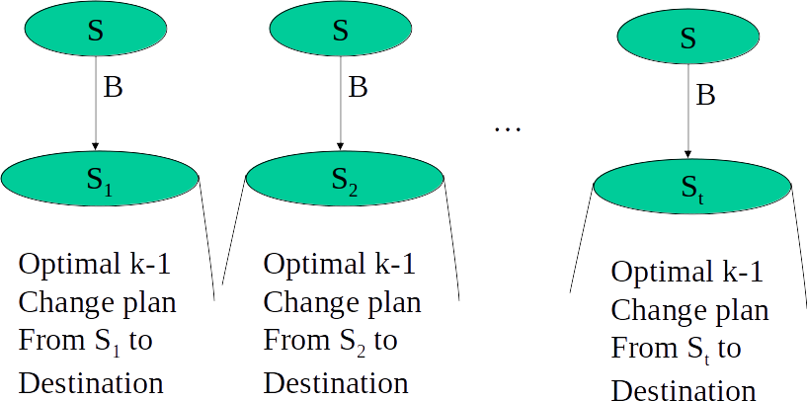
Plans with maximum k transfers:
Evaluate all t plans and find best.
Complexity: Օ( H (L + ClogC ))
H: max transfers given by user; L: sum of lengths of all bus routes; C: max number of buses at each stop

Slide 19
Round based Public Transit Optimized Router
Minimizes travel time and number of transfers
Requires no preprocessing
Easy to parallelize
Uses simple data structures

Slide 20
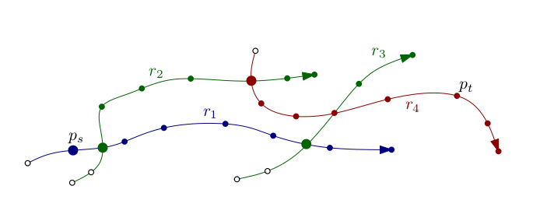
Works in rounds, where round k computes earliest arrival times to each stop p with exactly k transfers: τ_{k}(p)
Keeps earliest arrival time achieved so far for each stop from origin: τ*(p)
Each round takes as input only the marked stops.
Marked stops are those whose arrival time improved in the previous round
It then scans the routes served by these stops by traversing its stops in order and updating the arrival times whenever better arrival times are found.
Each round scans each route at most once.

Slide 21
Results: total running time of our algorithm is linear per round. In total, it takes Օ (K (∑_{r in R} |r|+|T|+|F|) time, where K is the number of rounds
London transit network graph | Round based trip planner average query time | Multi-Label Correcting average query time | Layered Dijkstra average query time
100,878 vertices 283,587 edges 10,000 random queries run | 7.3 ms | 65 ms | 43 ms

Slide 22
Need for Real-time data in Trip Planning
Problems:
Unreliable nature of bus schedules
Inaccurate travel times predicted
Bus bunching problem
Need for real time data:
To reduce amount of time wasted waiting for delayed vehicles
Better travel plans based on departure times

Slide 23
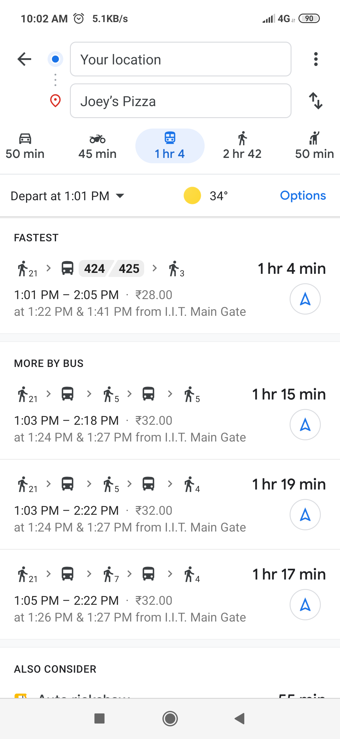
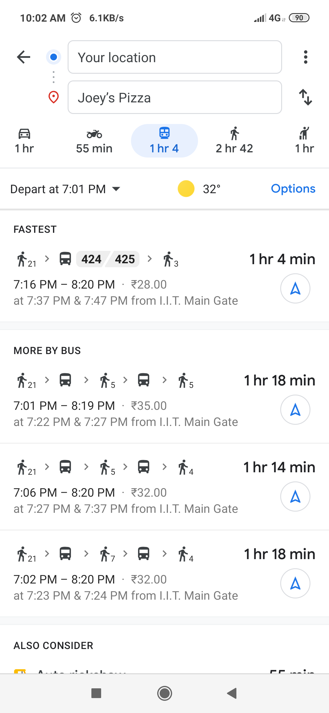
Current Trip Planners:
Similar routes for different departure times

Slide 24
Time-Expanded model algorithm
System architecture consists of client, server and third party information provider.
Client: selects origin and destination
Server: determines k shortest path between origin and destination
Third party: provides static and dynamic data
Static data: to build network graph
Dynamic data: to update wait and travel time between links

Slide 25
Set of optimal routes constructed in two steps:
Static network flow framework: Time expanded graphs used. Vertex (v,t) corresponds to stop v at time t. c_{(v,t)(v’,t’)} corresponds to the cost of an edge between vertex (v,t) and (v',t'). The size of this graph is very large.
Waiting subgraph: c_{(v,t)(v,t+1)}=1 ∀ v ∈ V, ∀ t < |T|-1
Walking subgraph: c_{(v,t)(v’,t+d(v,v’)/w)}= d(v,v’)/w for all pairs of walkable stops (v,v’)
Riding subgraph: c_{(v,t)(v’,t+d(v,v’)/r v,v’,t)} = d(v,v’)/r_{v,v’,t} for every pair connected by transit option.

Slide 26
2. Dynamic Network flow problem: As delay information of buses is obtained, the edges in the time expanded graph are replaced with new edges.
Suppose vehicle that left stop u at time 𝜽 and scheduled to arrive at 𝜽’ at destination, is delayed by time t_{d} dynamic updates take place, edge e_{(u,𝜽)(v,𝜽’)} is removed and edge e_{(u,𝜽)(v,𝜽’+td)} is added. Similarly all adjacent edges are updated.
(v,𝜽’)
(u,𝜽)
(v,𝜽’+td)

Slide 27
Experimental Results:
San Francisco | Schedule-based TTP error | Real-time TTP error
Over 600 trips. 87 routes across the city | 14.9% | 11.7%

Slide 28
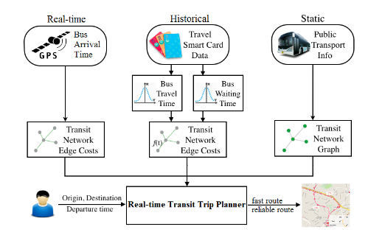
Time-Dependent model algorithm
Trip planner that uses both historical and real-time data of buses

Slide 29
Time-dependent transportation graph approach:
T^{l1}_{A,B}
r^{l1}_{A}
r^{l1}_{B}
Travel time
alight
Waiting time = w^{l1}_{A}
T^{l1}_{B,A}
alight
Waiting time = w^{l1}_{B}
t_{A}
t_{B}
Bus stop A
alight
alight
T^{l2}_{A,B}
Waiting time = w^{l2}_{B}
Waiting time = w^{l2}_{A}
Travel time
r^{l2}_{B}
r^{l2}_{A}
T^{l2}_{B,A}

Slide 30
Multicriteria Shortest Path Algorithm:
Each node ni stores the cost to reach node ni from origin.
Start with origin node with cost 0.
Pick lowest cost node in each iteration and examine all the outgoing edges and nodes associated with it.
Edge costs are added to the current cost.
If the new cost is better than already computed costs for that nodes, previously computed costs are removed.

Slide 31
Experimental results:
Real-time transit trip planner is compared with Google Maps 2 and Gothere.sg 3 in Singapore.
Accuracy of expected total travel time:
RTTP returns adaptive plans and favors fast and reliable routes.
Gothere.sg error | Google Maps error | Real-time Trip planner error
40% | 22% | 10%

Slide 32
THANK YOU

